Slide 1


Managing Data Centre Life Cycle
Corporate Deck 2024
Our Ikigai :
Sustainable Development

Slide 2

Managing Data Centre Life Cycle
Corporate AV
https://www.youtube.com/watch?v=xxmgnCKqJ_I&t=43s

Slide 3
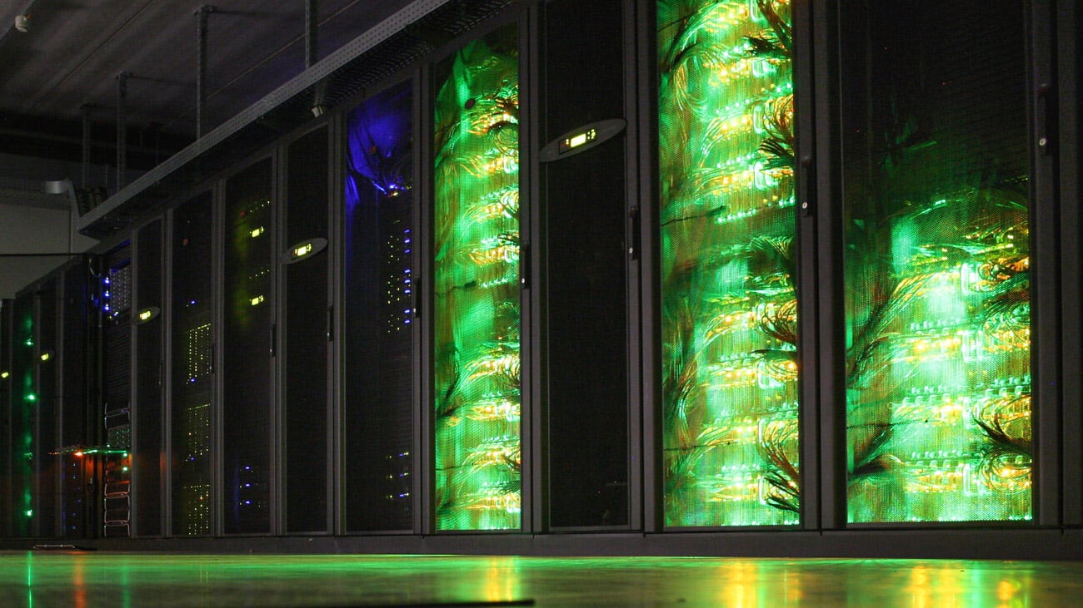
ABOUT US
Delivering Complete
Datacenter Life Cycle Management Services
Founded in the year 2000 by Mr. Asheesh Garg
Head Quartered in New Delhi -India.
More than 90% of customers are among the Top 500 Enterprises in India.
PAN India presence and capability.
Overseas offices soon.

Slide 4

ABOUT US
Delivering Complete
Datacenter Life Cycle Management Services
262+
400+
3 +
Designed and Built Tier/Rated Data Centers across India
On-site Manpower (on rolls) deployed Across India
Data Center
Audits
24+
112+
560+
Years of
Experience
Managing Data Centers ( DC and DR ) across India
Locations
covered
across India

Slide 5
VISION
MISSION
To foster long-lasting
and mutually meaningful partnerships with our customers and business associates by always delivering a credible, ethical, and consistent solution
to their business needs.
Building Trust..

Slide 6
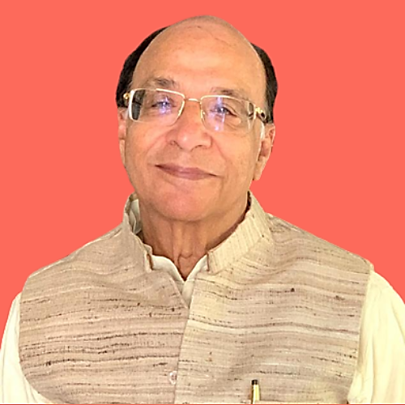
Leadership
Education & Experience
Rare Distinction of Launching the Email Service In India
Post Doctorate from IIT Delhi
Has been a Founder Member & Served in the past as Vice President of the “Internet Service Providers Association of India.”
Ph.D. in Physics ( Radio & Telecommunications) from IIT-BHU
Has Global Experience working in Leadership Positions with SITA Telecommunications, SPRINT RPG India Ltd & Govt of India.
Dr. V. K. Garg
One of the Key architects in formulation of the Internet Policy by the Government of India.
Chairman

Slide 7
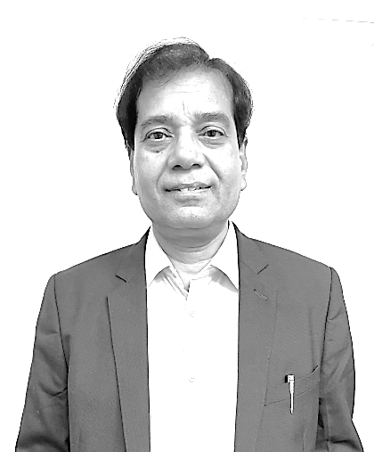
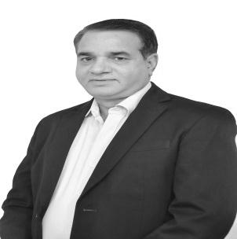
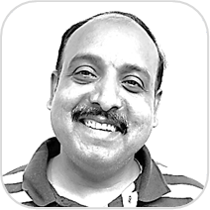
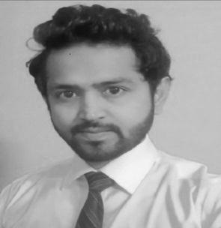

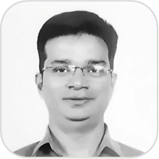



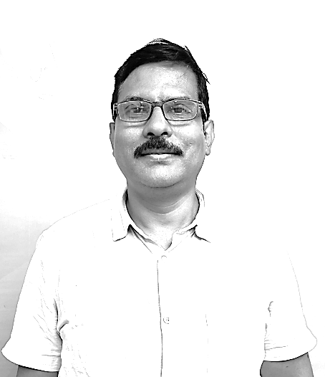
Team
Meet Our Team
Arin Sarkar
Vinod Sharma
Mithilesh Singh
Gunjan Das
Prashant Singh
Vice President
Chief Technology Officer
General Manager
Senior Lead PMO
AVP- Strategic Alliances
Shri Ram Ranawat
Ayush Gupta
Prachi Vashistha
Kirti Sharma
Mahesh Singh
DGM Sales
Business Development Executive
HR Executive
BDM
Manager- Accounts

Slide 8
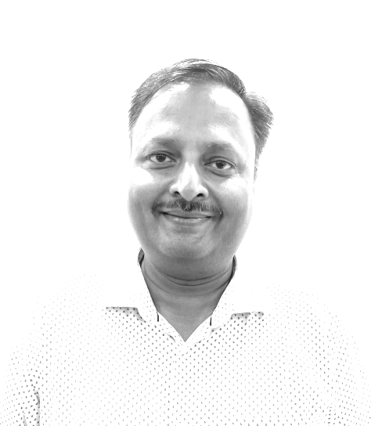
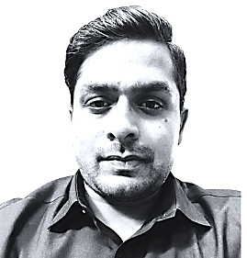
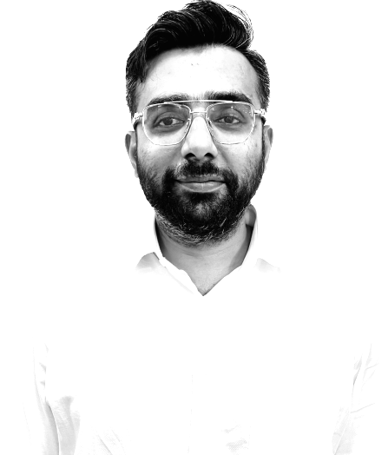
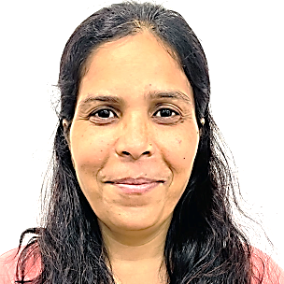
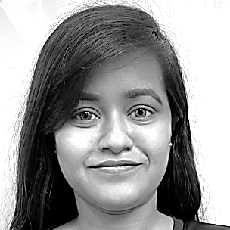
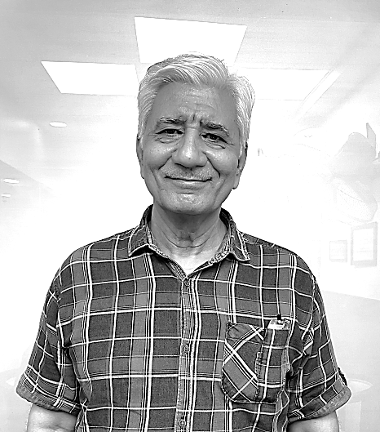
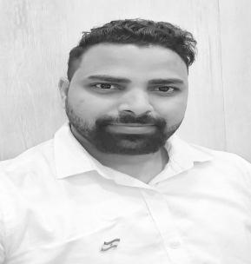
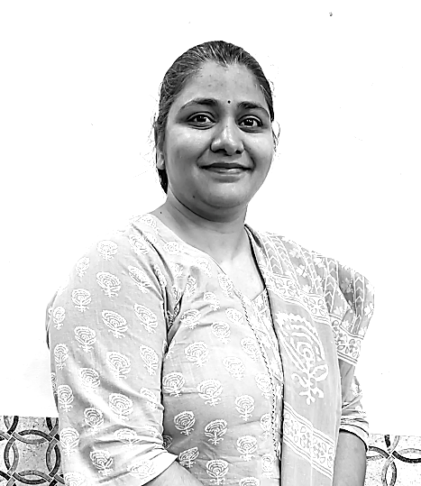
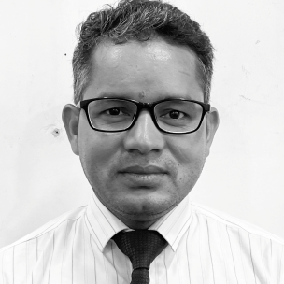
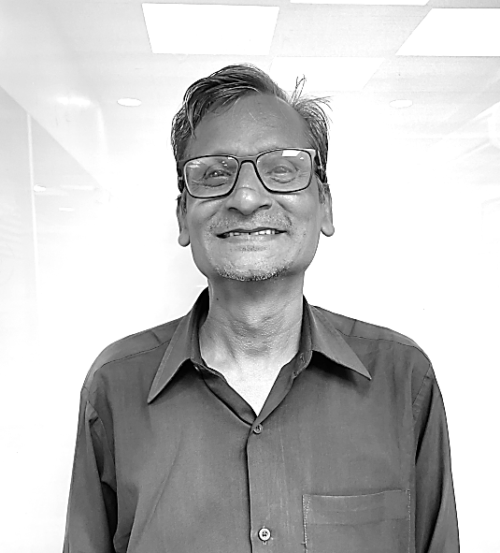
Team
Meet Our Team
Vivek Bansal
Pankaj Rajput
Haris Naved
Neetu Kumari
Annasa Biswas
Sr. Project Manager
Sr. Solution Architect
GM - Projects
Asst Manager HR
Interior Designer
Anup Sayal
Ravi Mandal
Jaswinder Kaur
Bhuvan Singh
Uday P. Singh
FMS In-Charge
Bid Manager
Tender Executive
Manager- Operations
Technical Lead- North

Slide 9
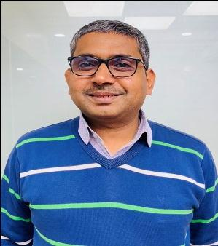
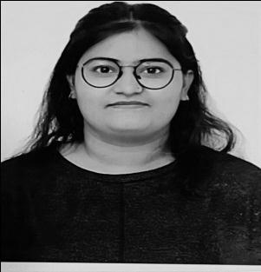
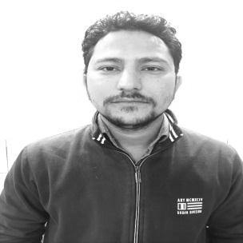
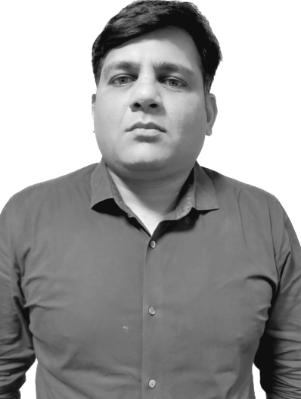
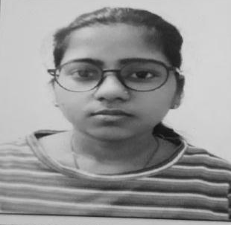
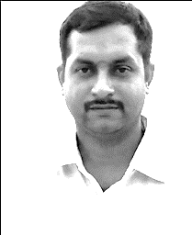
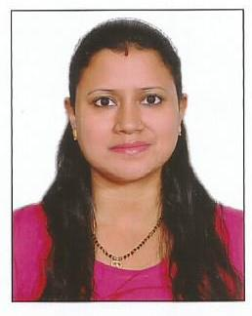
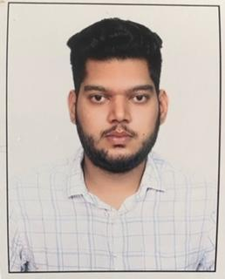
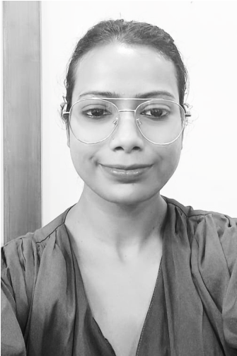
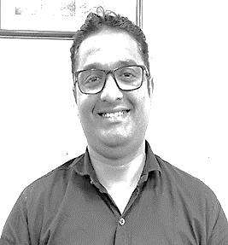
Team
Meet Our Team
Nirmal Prasad
Shivangi Jha
Dheeraj Singh
B S Kiran
Jyoti Kumari
DGM (Critical Infrastructure Services)
Assistant Manager- Govt. Sales
Manager (Datacenter –Design & Engineering)
Zonal Manager- South
Accounts & Finance
V. Laxminarayan
Shalini Chakrabarty
Uttkarsh Sharma
Vijaya Kumari
Sunil Gupta
Project Manager
Sr. Purchase Executive
Sr. Project Coordinator
Sr. HR Executive
Admin
and many more..

Slide 10
Recognitions Over Last Few Years..
2017
2021
2022
Nominated as Best MSME for Excellence
NASSCOM Listed Nikom as one of the
“ Major Players in Datacenter Ecosystem” in India
Runner’s up in
ASSOCHAM
Excellence Award for Best MSME
2016
2019
2021
2023
“ Best in Class ” Award for APJ Region for Green DC and Energy Management.
Most Promising Datacenter Solution Providers by
“ Silicon India Magazine “
Most Promising Datacenter Solution
Providers by “ Silicon “ Magazine
Rated as SME 01 in Performance Rating
by ” Brickworks Analytics”

Slide 11
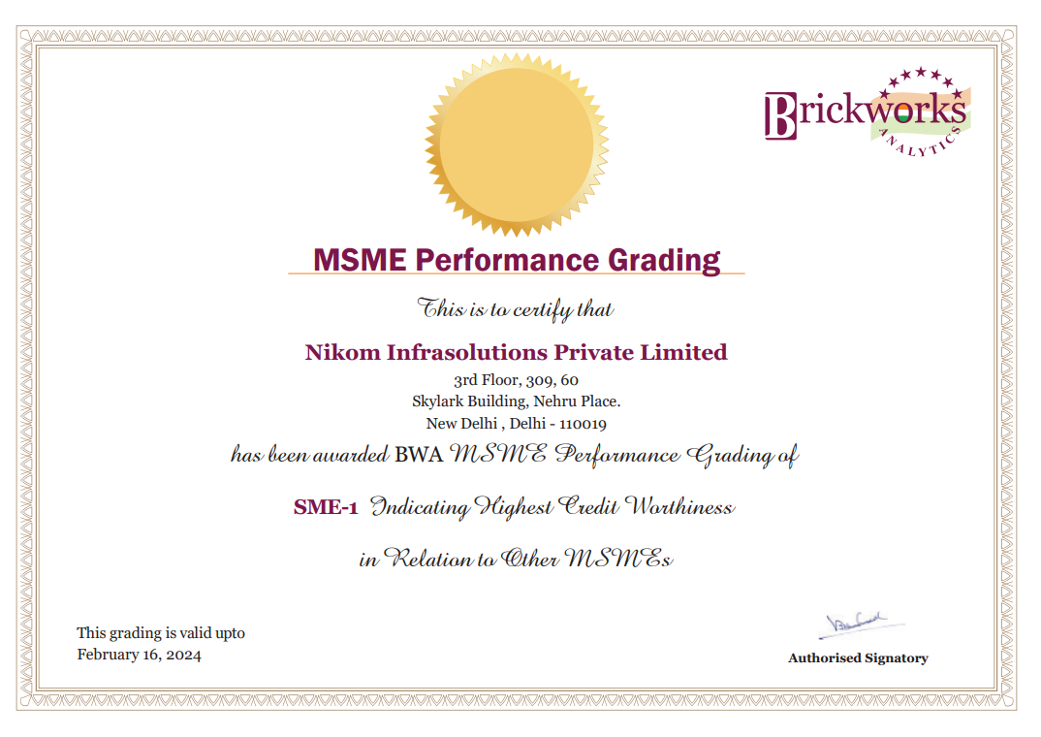
MSME Performance Grading
Rated as SME 01 in Performance Rating by ” Brickworks Analytics”

Slide 12
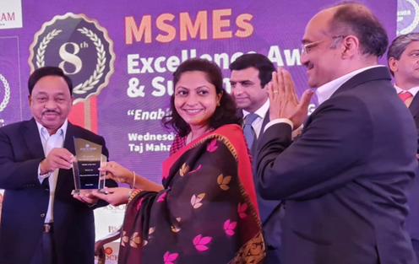
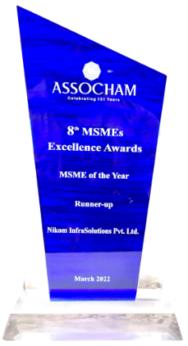
ASSOCHAM Award ( 2022 )
Director, Mrs Swati Garg and MD, Mr Asheesh Garg , receiving the MSME Excellence Award from Honorable Union Minister of MSME, Sri Narayan Rane

Slide 13
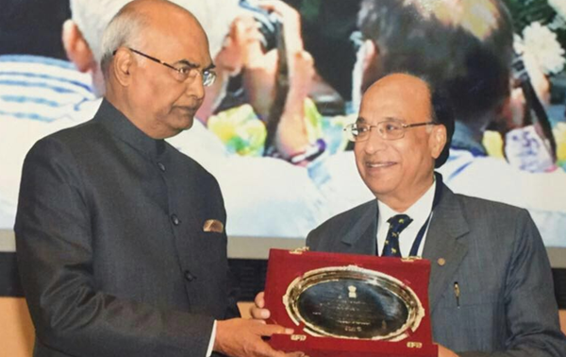
Vayoshrestha Samman ( 2017 )
Chairman, Dr. V. K. Garg Receiving National Award on behalf of his father for significant philanthropic contribution
in the Education and Health sector from the Honorable President of India.

Slide 14
Feb’ 2021
NASSCOM listed
NIKOM
as
“Major Player in
Data Centre Ecosystem”
In
India

Slide 15
Quality Certifications & Associations
Member of ISHRAE
Member of IGBC ( CII Green Initiative )
Member of GDCA
(Green Datacenter Alliance)
ISO 9001, ISO 14001,
ISO 27001, ISO 20000 and
ISO 45001 certified.
Developed and implemented a World Class registered and patented CMMS software tool “ Intelli-Tao”.
Got the “Best in Class Award” in APJ for Green DC and Energy Management

Slide 16
Data Centre Lifecycle Management
Build out & Cooling Solutions
Audits & Energy Management solutions
01
03
05
02
04
Feasibility & Design
Project Management
Operations & Infrastructure

Slide 17
Competencies
DC Design, Build & Consultancy
Smart City Solutions
E-Government Solutions
DC Operations & Maintenance
Energy Management Solutions
IT & Networking Solutions
DC Project Management
AV/ Smart Rooms
Operations Command Centre
Data Centre Retrofit Projects
Grid to Chip Turnkey EPC Projects
Data Centre Audits

Slide 18

Portfolio
Racks- Edge / Smart Racks
Datacentre Monitoring & Management
Civil Structure & Interiors
Modular Smart UPS & PDUs
Electrical Works (LT & HT)
Smart Furniture & Ergonomic Consoles
Specialized Cooling & Power Solutions
Videowall and Smart Displays
IP Telephony
Hyper Computing Cooling
Safety and Security ELV Solutions
Passive, IT and Wi-Fi solutions

Slide 19
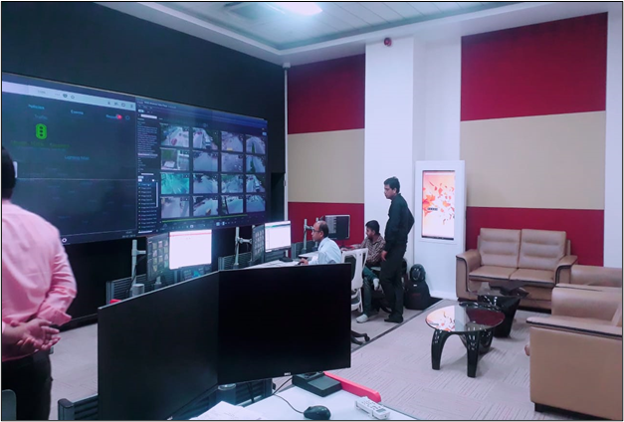
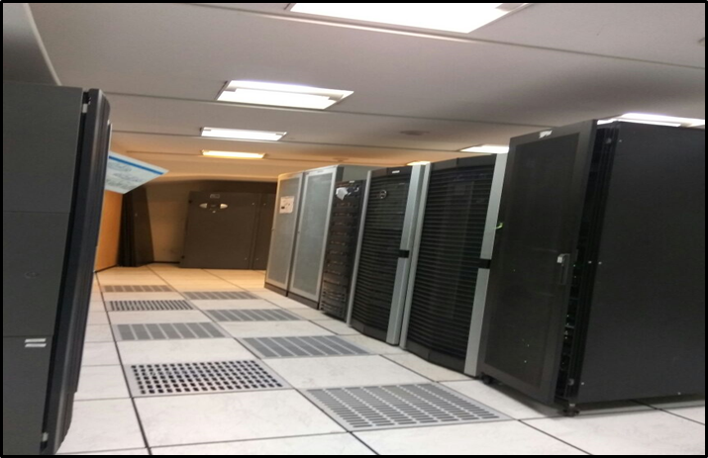
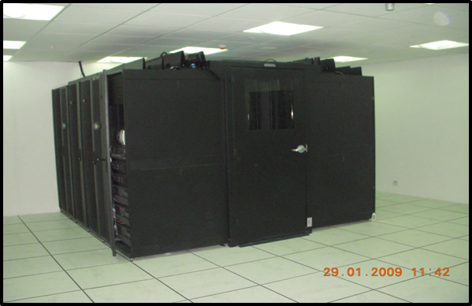
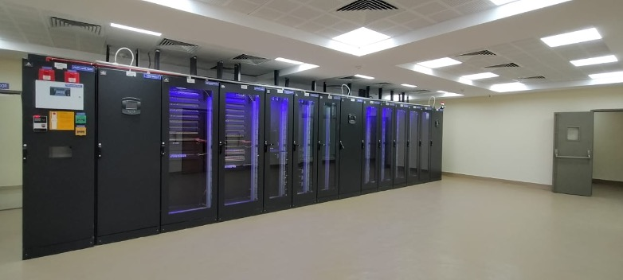
Projects
MileStone Projects
Aviva Chennai
ONGC - Head Quarter
NHPC datacentre
Jaipur Smart City
Disaster Recovery Centre
Vasant Kunj, New Delhi
Command & Control Centre

Slide 20
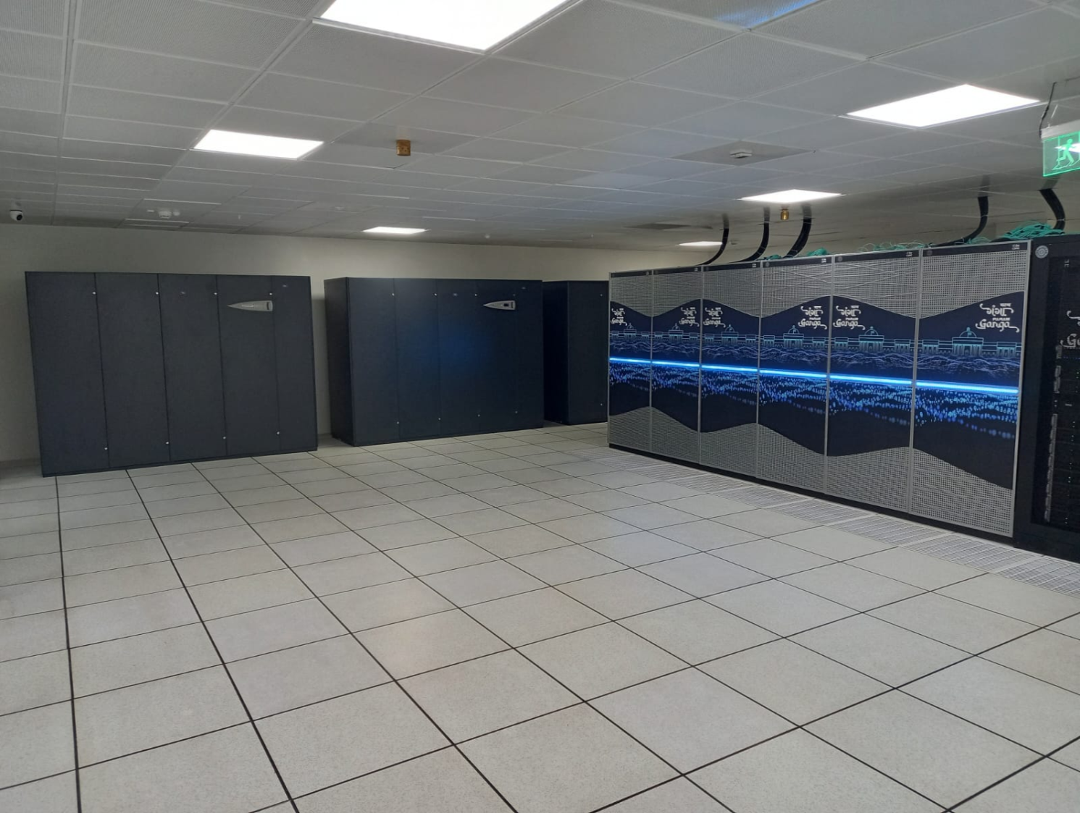
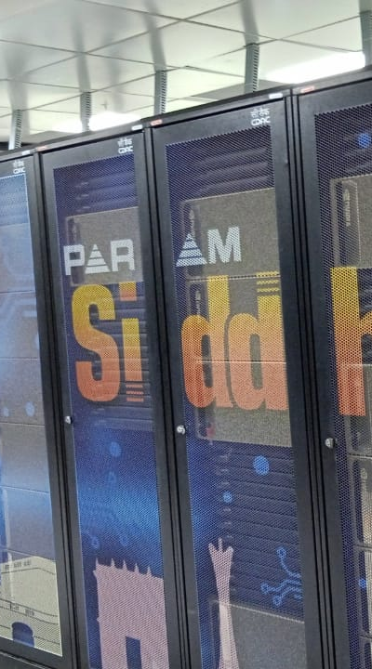
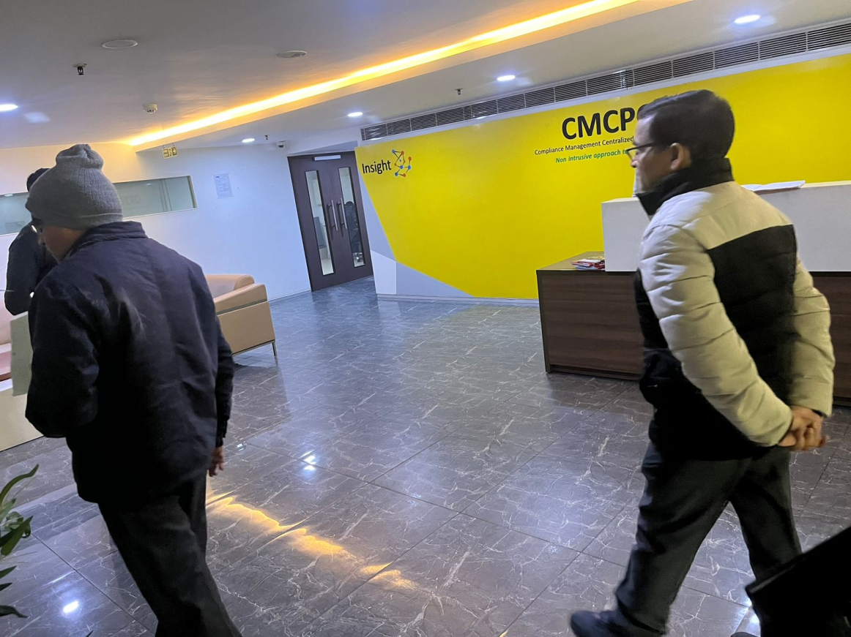
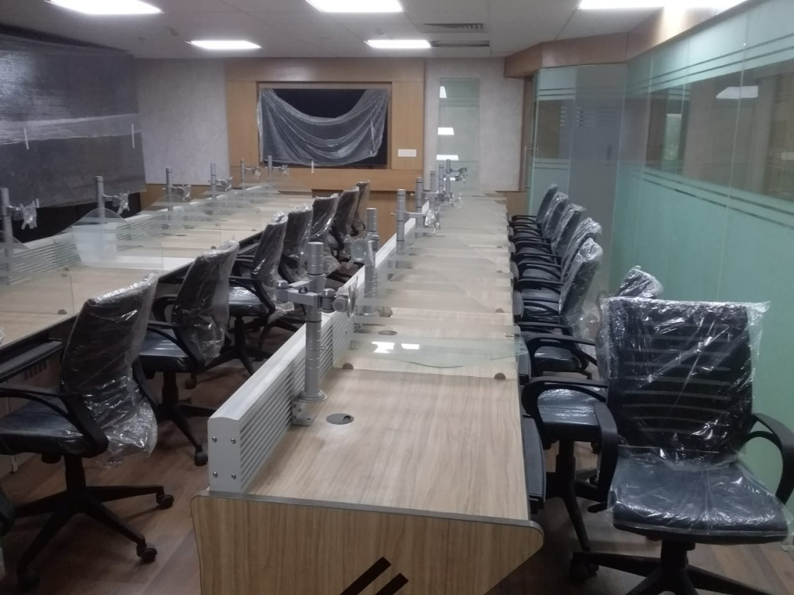
Projects
Milestone Projects
MHA-ICR-ER
L& T Info Tech
Param Siddhi
@ CDAC, Pune
Param Ganga@ IIT Roorkee
Data Centre & Furnishing
Income Tax Dept.
Vaishali, Ghaziabad
Super Computing Centre
Super Computing Centre

Slide 21
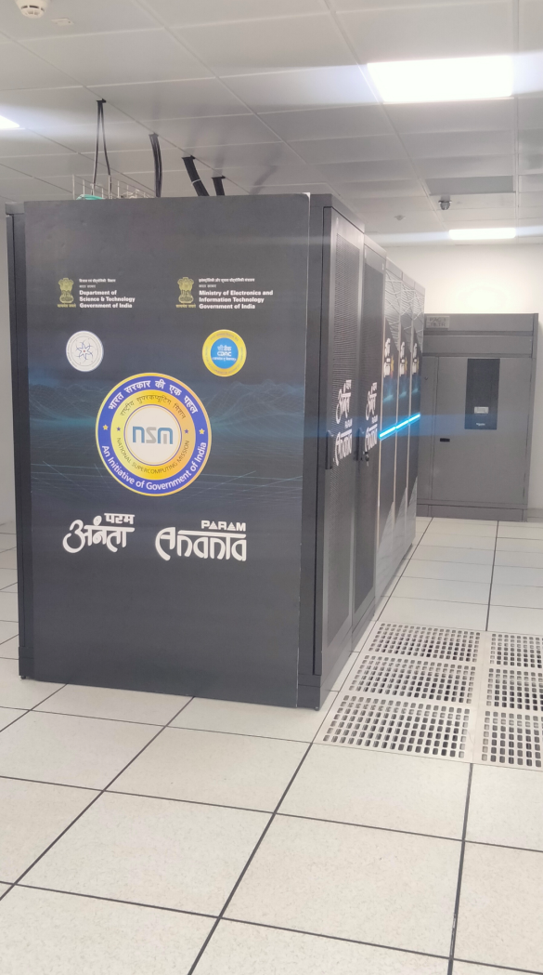
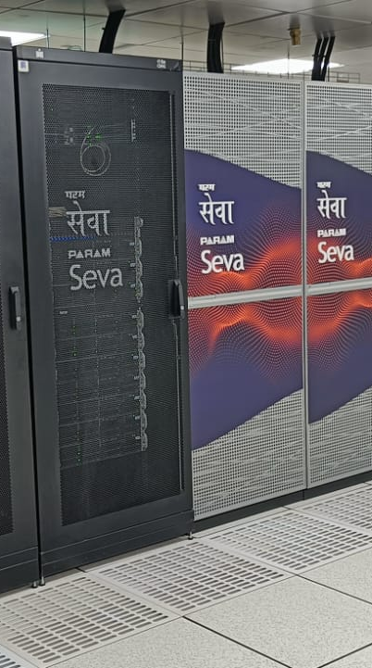
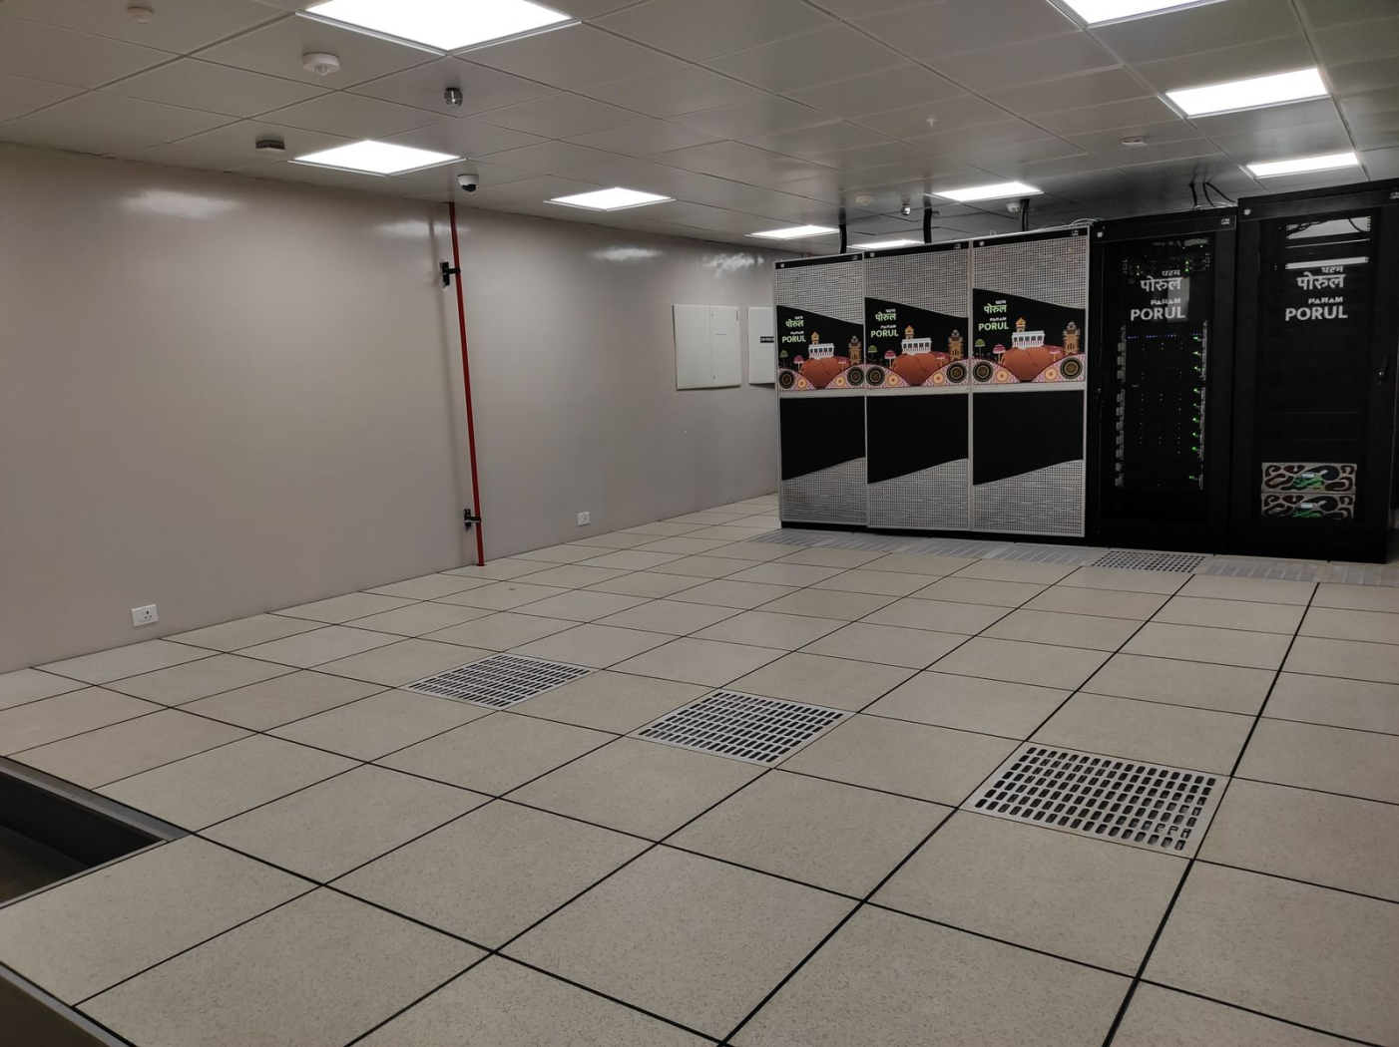
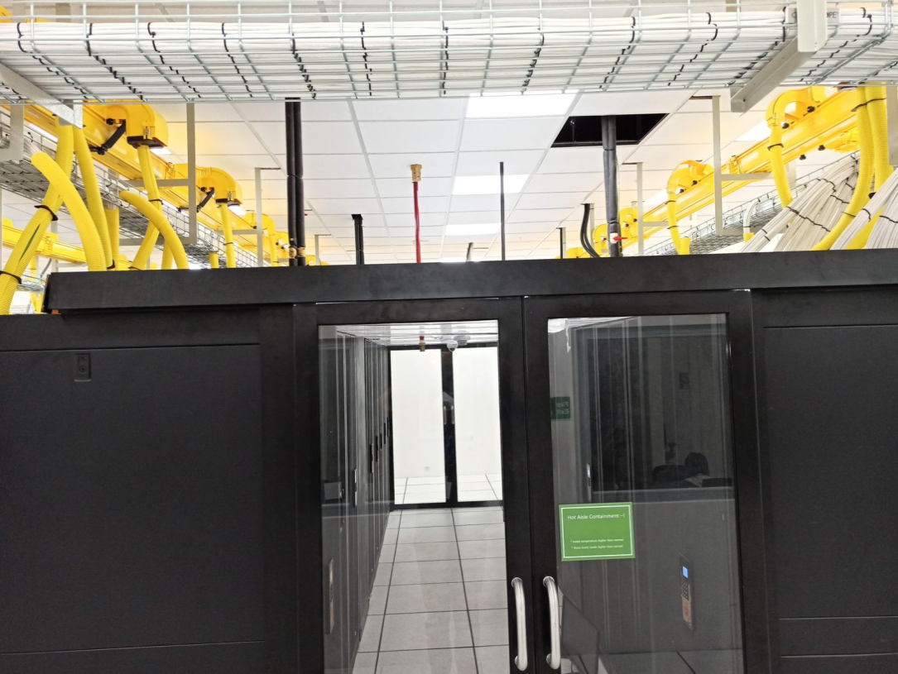
Projects
Milestone Projects
AAI- Hyderabad
NIT-Trichy
IIT Hyderabad
IIT- Gandhi Nagar
Data Centre
Data Centre
Param Sewa - Super Computing Centre
Data Centre

Slide 22




























Organizations that trust us
Infrastructure
Infrastructure
Transport
Transport
Utilities
OiL & GAS
Power, Oil & GAS

Slide 23





























Organizations that trust us
InfoTech
Telecom
Hospitality
Defence
Education
R & D
Healthcare

Slide 24

















Organizations that trust us
Consulting
IT / ITES
Manufacturing
BFSI
NGOs

Slide 25















Partners that trust us
Empanelment Partners
Empanelment Partners
Alliances
Alliances
Alliances
Few More..

Slide 26
Projects
Few Recently Completed
Prestigious Projects :-
262+
Designed and Built Tier/Rated Data Centers across India
CDAC Pune HPC Data Centre
AAI, Hyderabad ( DR )
CDAC Bengaluru HPC
Data Centre
IOCL, Gurugram Data Centre
IIT Hyderabad HPC Data Centre
NHPC, Faridabad, Data Centre
ONGC, Mumbai Data Centre
Bank of India DC , Mumbai
400+
3 +
ONGC , Delhi Data Centre
Medanta Data Centre,
On-site Manpower
(on rolls) deployed Across India
Data Center
Audits
IOCL, Gurugram Data Centre
CSIR, Hyderabad
CRIS- Southern Railways
Data Centre

Slide 27
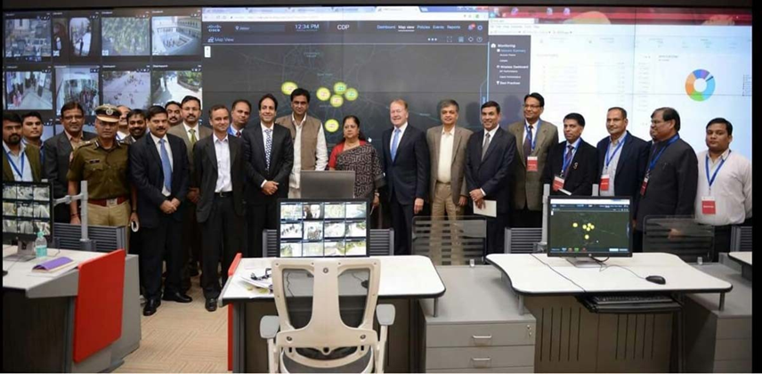
Jaipur Development Authority Smart City Project – Command & Control Data Centre
“Hon’ble CM of Rajasthan” & “CEO of Cisco”, Mr. John Chambers at the Inauguration of JDA Smart City Project

Slide 28
Projects
Key O&M Customers :
AAI AOCC 6 locations
CDOT , Data Centre, Delhi
23+
AAI Chennai
RCFL , Mumbai
Years of
Rich Experience
AAI DR Hyderabad
Punjab National Bank , Delhi
AAI Chennai N/W
Bank of India , Mumbai
IIT Hyderabad
LIC of India , North Central Zone
JDA, Command Centre , Jaipur
112+
560+
PGCIL DC, Manesar
UPCL DC & DR, Uttarakhand
IIT Roorkee
Managing Data Centers
( DC and DR ) across India
Locations
covered
across India
HPSEB Data Centre, Shimla
IIT Gandhinagar
ONGC Data Centre, Delhi
NIT Trichy

Slide 29
SCOPE
01
Clearly Define the Scope
of the Project
02
QUALITY
Constant Quality Management
Key Elements
of Project Implementation
03
EFFORTS
Continuous Efforts to
Monitor & Track
04
RISK
Proper Risk Management
05
TIME
Effective Time Management

Slide 30

Rack Infrastructure Management
Infrastructure management system ensures matching of facilities resources and changing IT needs.
Prevents downtime, reduce operating expenses, improves resilience and response.
Can provide centralized, real-time monitoring of all rack assets

Slide 31
Support Methodology
Environmental Health & Safety
Personnel Engagement
Incentive model / retention )
Our Competencies
Maintenance Management
Emergency Preparedness and response
Asset Management
Change Management
Documentation Management
Training
Infrastructure Management
Quality Management
Energy Management
Performance Monitoring & Review

Slide 32

Environmental Health & Safety
Comprehensive Workplace Safety Program
Our Competencies
Injury & illness Prevention
Electrical Safety
Hazard Analysis & Communication
Personal Protective Equipment (PPE)
Compliance with Applicable Health & Safety Laws

Slide 33

Personnel Engagement
Ensuring a “ Mission Critical Mentality”
SME from disciplines like Electrical, Mechanical,
Controls, Fire, Quality Management , Training, and
CMMS , DCIM, BMS systems
Our Competencies
Staffing Model in tune with facility systems,
business functions, and operational mandates.
Well defined roles and responsibilities .
Ensuring compliance to all GOI wage and labor
regulations.
Reward & Recognition Programs.
Last but not the least , Communicating .

Slide 34
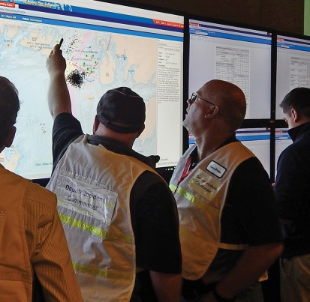
Emergency Preparedness
Timely, Effective and Error-free Response
Developing EOP* for safely isolating faults & restoring service or redundancy when possible.
Our Competencies
Escalation Procedures.
Scenario drills to be conducted.
RCA to be conducted.
Formal Failure Analysis
*EOP - Emergency Operating Procedures

Slide 35

Change Management
Making a detailed checklist of each step .
Date/time/site/contact info/procedure
review/predicted effects / documentation/
safety requirements/risks and assumptions/
step by step work details/back-out procedures /
approvals/completion sign-offs/ feedback
Our Competencies
Coordination with OEM vendors and 3rd party
service providers.

Slide 36

Documentation Management
Records of critical infra to
be well – organized.
Our Competencies
“Intellitao” Customer Support
Management software
Right documentation ensures business and operational seamlessness and continuity.

Slide 37

Training
Suitable Training Program
Basic, Intermediate , and advanced
Training program ensuring all technicians etc are abreast of latest developments.
Our Competencies
Engineer / supervisors etc. to have requisite qualifications/ updated certifications.
Training program ensuring all technicians etc
are abreast of latest developments.
Our Competencies

Slide 38

Quality Management
Focus on Quality and Improvement .
Quality Assurance (Process Standardization)
Our Competencies
Quality Check ( Checks, Inspections, and Audits)
Our Competencies
Continuous Quality Improvement

Slide 39

Energy Management
Performance Benchmarking
( existing energy usage ; cost reduction program; etc.)
Our Competencies
Efficiency Analysis ( means to increase efficiency of power and cooling infra)
Strategic Energy Sourcing

Slide 40

Performance Monitoring & Review
Quality Process.
Safety Policy Conformance
Key KPIs
Emergency Response Procedure
Load Uptime
Quality Control
Load Redundancy
Operational Reporting
Support System Uptime
Event Notification and Escalation
Maintenance Completion
Timely and Accurate Cost Reporting
Staffing Coverage

Slide 41

Incident Management Solution
Ensures smooth operations throughout Data Centre lifecycle
Planned PM and predictive maintenance Plans
Improving equipment reliability and system availability
3 main tasks -
Asset Management
Work order Management
Spare parts Management
In-house CMMS (Computerized Maintenance Management System) Intellitao

Slide 42
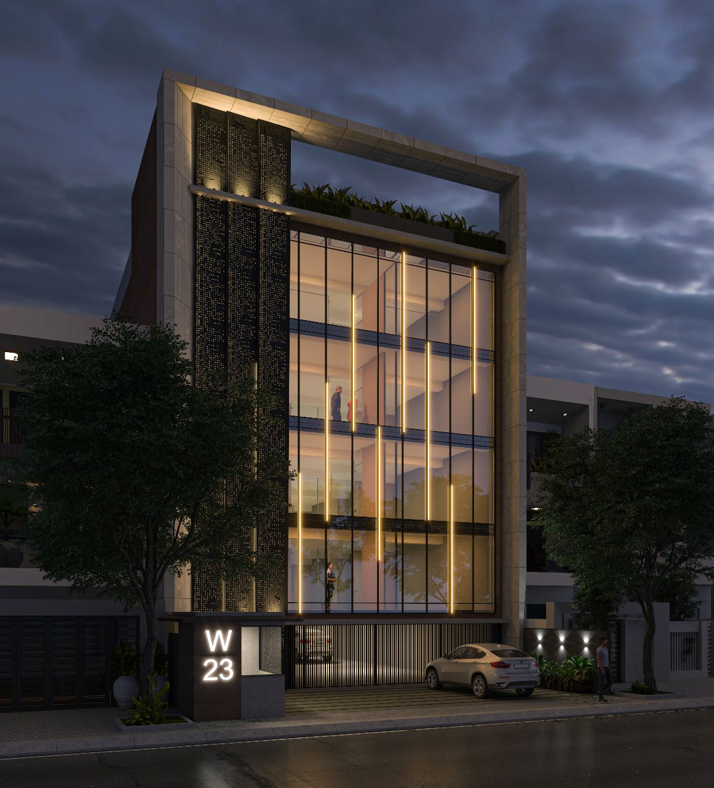
And the journey continues !!
Nikom InfraSolutions Pvt. Ltd.
Managing Data Centre Life Cycle..

